Slide 1
Voltage Collapse Prediction Using Machine Learning
01

Slide 2
Course Name : EEE-306
Course Title : Power System 1 Laboratory
Subject : Project
Course Instructors:
Dr. Md. Nasim Ahmed Dewan
Professor, EEE, BUET
Md. Fatin Ishraq Faruqui Lecturer (PT), EEE, BUET
Submitted by:
Group 1
ID:2006066
2006067
2006068
2006069
2006070
2006071
02

Slide 3
Overview
Introduction
Motivation
NLSI_1
Methodology
Working Pipeline
Data Generation
IEEE 14 BUS System
Demonstration
Decision Tree Algorithm
Results
Future Prospect​
References​
03

Slide 4
Introduction
Voltage collapse poses a critical challenge to power grid stability.
Developing a robust and reliable machine-learning model for early voltage collapse prediction.
Creating a Dataset.
By anticipating voltage collapse, we contribute to the resilience and efficiency of the power grid infrastructure.
04

Slide 5
Motivation
Challenges in Power System Management
Risk of Voltage Collapse
Need for Monitoring and Early Warning
Shift Towards Machine Learning
Efficient Prediction Models
05

Slide 6



New Line Stability Index (NLSI_1)
a stability indicator
Efficient Normalized Range: NLSI_1 values range 0 to 1
Normalizing NLSI_1 value
06

Slide 7
Methodology Block Diagram
Generation of training and testing data [ PSAF]
Data pre-processing
Finding best ML model
prediction
Compare actual and predicted values
07

Slide 8
Working Pipeline​
Problem Identification
Training Data Generation
Input Feature Selection
Implementing ML Algorithm
Train ML Algorithm
Simulation and Validation
08

Slide 9
Data Generation​
IEEE 14 Bus system
Input to PSAF, load flow Analysis
Took the values of Voltage and angle
V, Q, Z, X, δ, δc input to MS EXCEL
Calculating NLSI_1
Normalizing NLSI_1
09

Slide 10
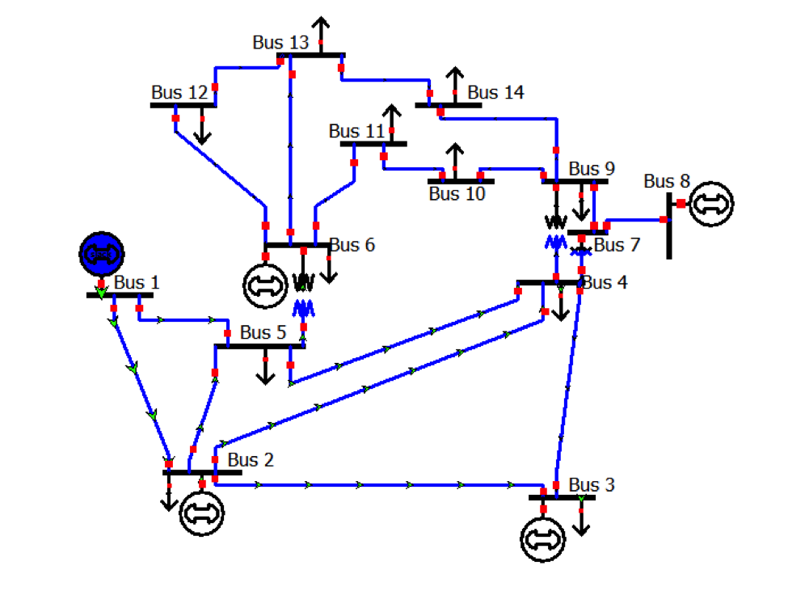
IEEE 14 Bus system
10

Slide 11
Demonstration
load Data ( Q, V, Z, X, δ, σ) and Preprocessing
Splitting Dataset into test and train Data
Fit polynomial and feature Scaling
Train Models and select the best one
Make Prediction with the best fitted Model
11

Slide 12
Finding best ML model
Model Name | R-squared Value
GradientBoosting | 0.9202938198434416
RandomForest | 0.915366212247379
Ridge | 0.8058867651342346
Lasso | 0.8044845394190461
SVR | -0.09128112568721769
KNeighbors | 0.8633362926583045
Decision Tree | 0.9221138779941593
XGBoost | 0.9098069485129625
MLP | -0.09128110669006895
AdaBoost | 0.8854694806961242
Bagging | 0.9221360021528593
ExtraTrees | 0.9204986262914252
Voting | 0.9164003627362303
LGBM | 0.8492909580376518
CatBoost | 0.9116026450350005
12

Slide 13
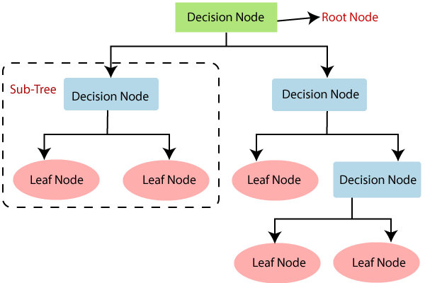
Decision Tree Algorithm
13

Slide 14
Decision Tree Algorithm
One input
Entropy
Information Gap
Root Node
Decision Lode and Leaf node
14

Slide 15
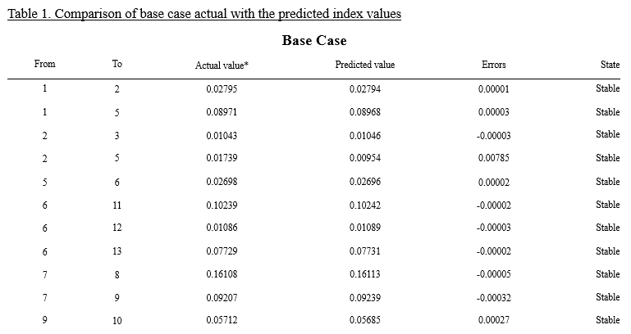
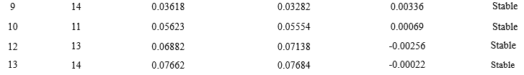
Results
15

Slide 16
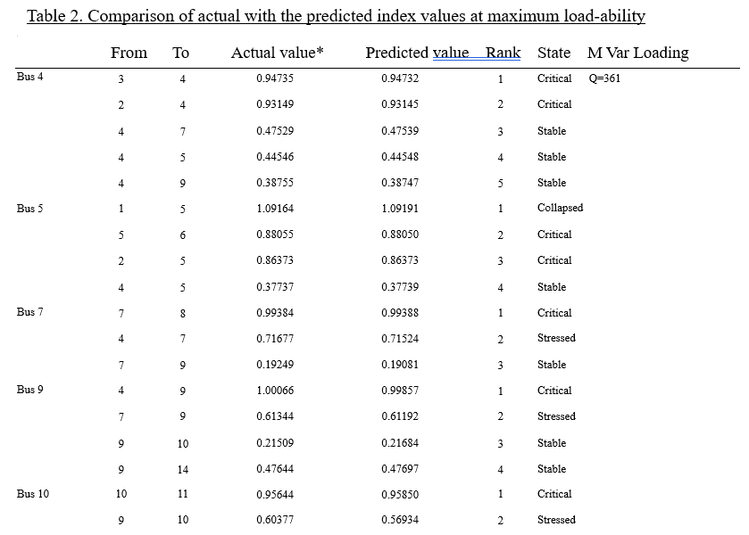
16

Slide 17
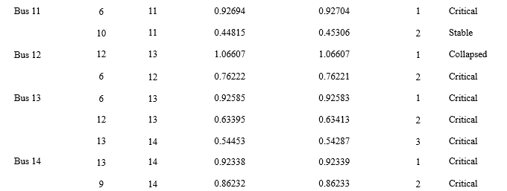
Continued>>
17

Slide 18
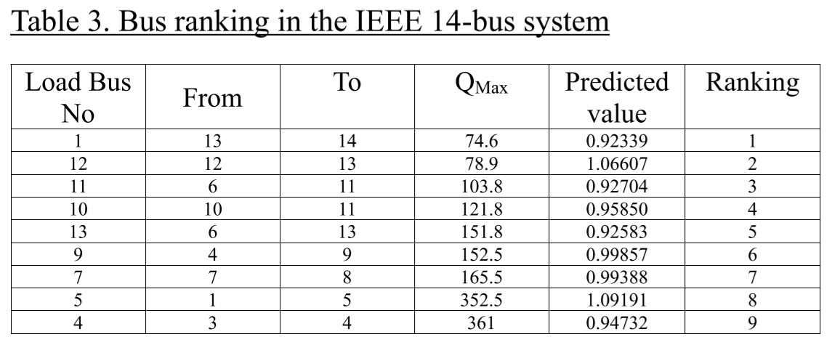
18

Slide 19
Future Prospect​
Integration with Smart Grids
Enhancement of Predictive Accuracy
Real-time Monitoring Capabilities
Adaptation to Evolving Power Systems
Collaboration with Industry Standards
19

Slide 20
Program Outcomes(PO)
Program Outcomes(PO)
Work | Corresponding PO | Description
Risk of Voltage Collapse | PO(a) | Investigate
Using PSAF 2.81, MS EXCEL, Python and Jupyter Notebook | PO(e), PO(c) | Use of power system analysis tools
Distribution of work among team members and helping each other out in every problems | PO(i) | Individual work and teamwork
Cost analysis, project presentation | PO(k), PO(j) | Demonstrate, Communication
20

Slide 21
References​
Shakerighadi, B.; Aminifar, F.; Afsharnia, S. Power systems wide-area voltage stability assessment considering dissimilar load variations and credible contingencies. J. Mod. Power Syst. Clean Energy 2019, 7, 78–87.
Ibrahim, M.H.; Jasim, A.H. Voltage Collapse Prediction of IEEE 30-Bus system. Tikrit J. Eng. Sci. 2021, 28, 98–112.
Mokred, S.; Wang, Y.; Chen, T. A novel collapse prediction index for voltage stability analysis and contingency ranking in power systems. Prot. Control. Mod. Power Syst. 2023, 8, 7.
Samuel, I.A.; Katende, J.; Awosope, C.O.; Awelewa, A.A. Awosope Claudius Prediction of Voltage Collapse in Electrical Power System Networks using a New Voltage Stability Index. Int. J. Appl. Eng. Res. 2017, 12, 190–199.
Isaac, S.; Adebola, S.; Ayokunle, A.; Katende, J.; Claudius, A. Awosope Claudius Voltage collapse prediction using artificial neural network. Int. J. Electr. Comput. Eng. 2021, 11, 124–132.
21

Slide 22
Thank you
Any Query?
22

